Slide 1
BudgetMinder
Tim McVicker, Team #12
17April 2017
CPSC 4820
Clemson University

Slide 2
Introduction

Slide 3
Problem
Want a centralized account manager
Want to input myself, and track balance
Want something I can use as a digital checkbook
Want to show statistics based on location/type of expenditure
Most of all: want something easy to use

Slide 4
Approach
Simple login/register
Simple input of transactions (income/expenditures)
Simple input of location/type of transaction
Use of GPS and android location services for location if desired
Simple, easy to read statistics

Slide 5
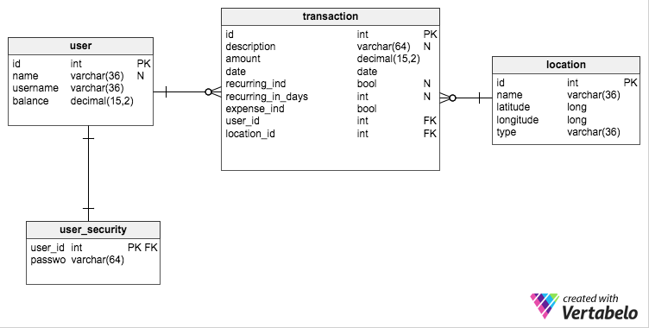
Database

Slide 6
DEMO
https://people.cs.clemson.edu/~tmcvick/cpsc4820/budget/get_all_users.php

Slide 7
Opportunities For future development
Increase in different statistics displayed
Giving users more control over accounts/locations

Slide 8
Acknowledgments
Dr. Roy Pargas
Sydney Paul
Rob Percival and his tutorials
Codepath.com
Android studio developer guide

Slide 9
Questions?

